Slide 1
Get Started With Serverless
👋
TJ VanToll
Principal Developer Advocate
Notes:
Introductory level talk

Slide 2
Serverless 101

Slide 3




Notes:
Over the last few months though

Slide 4
Notes:
Spent a lot of time researching

Slide 5
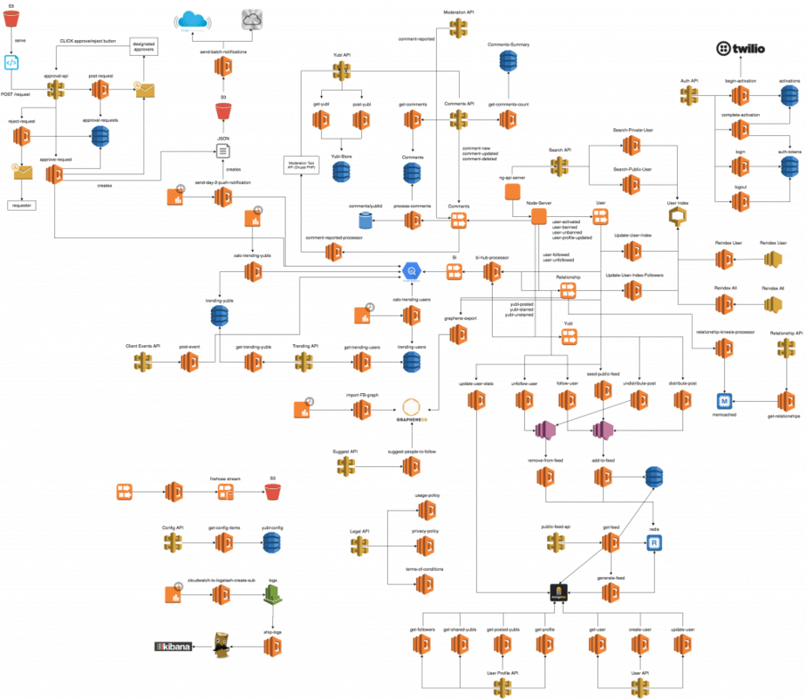
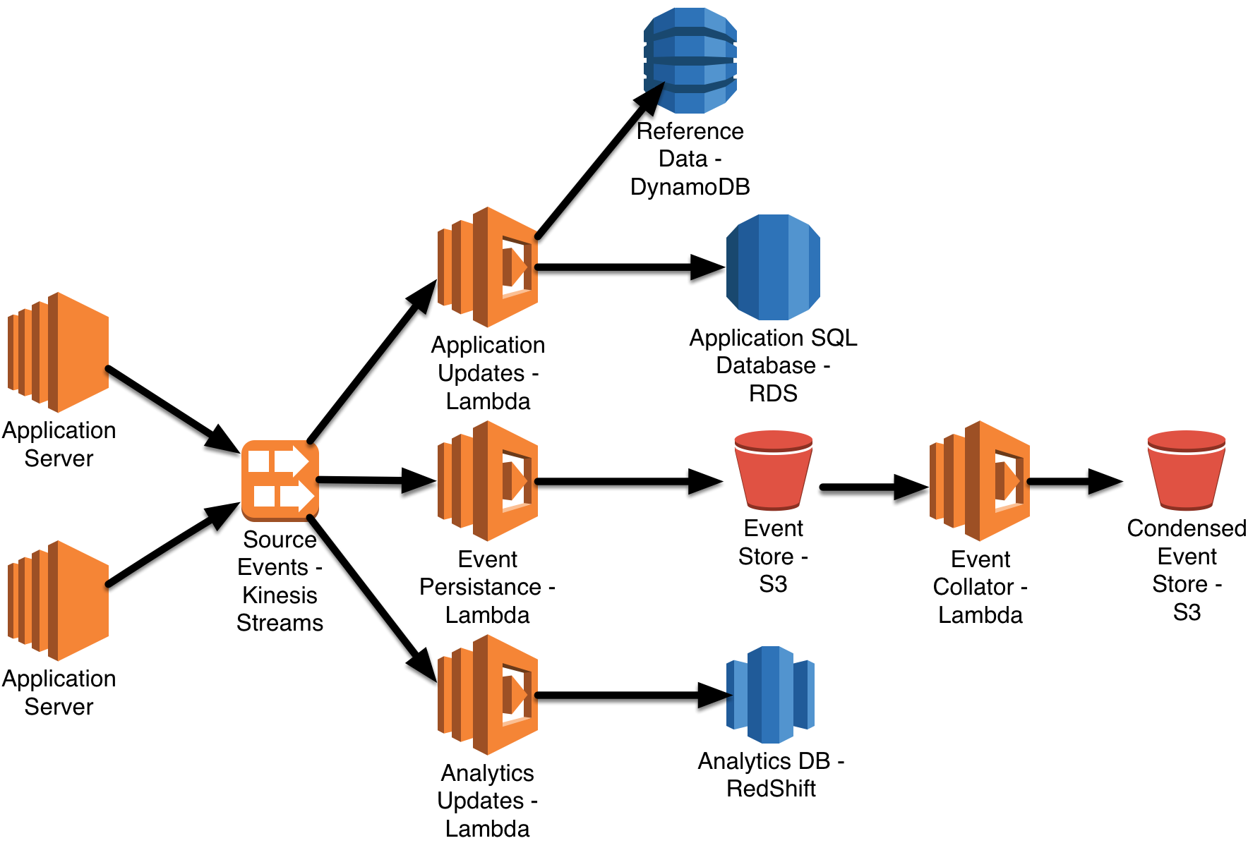
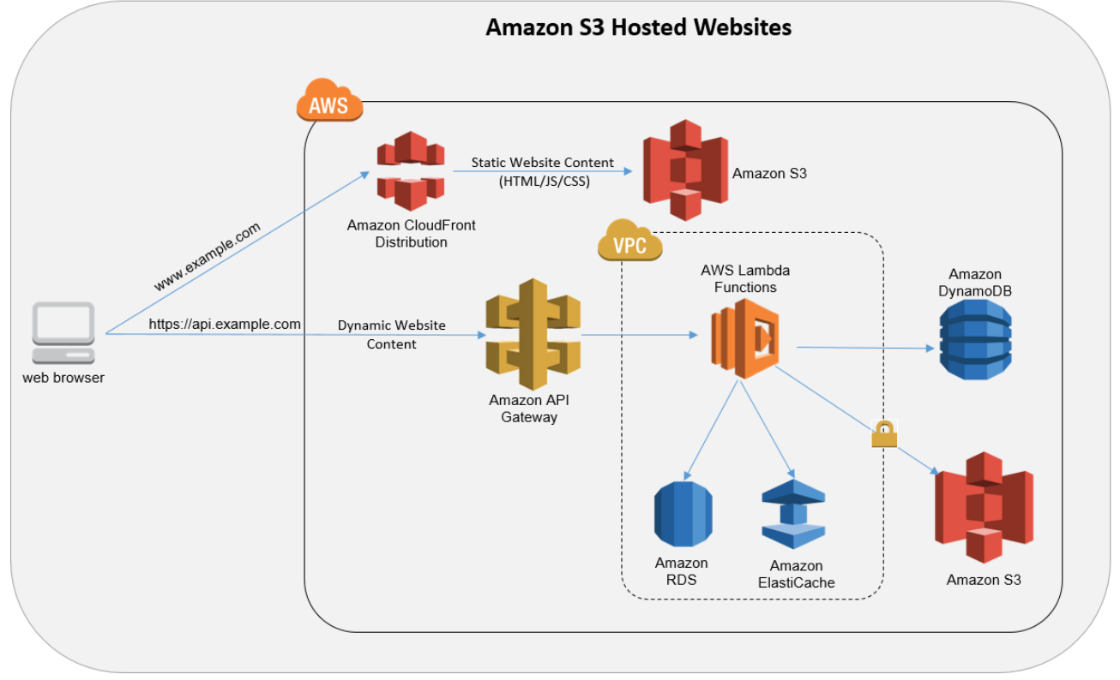
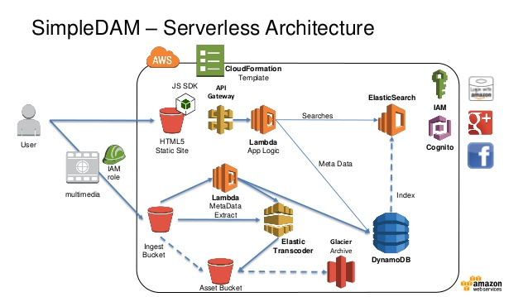
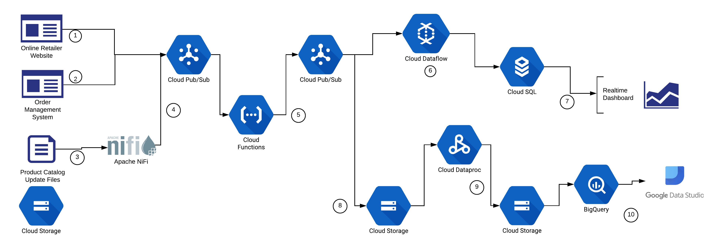
lol simple

Slide 6
Agenda
Introduce serverless
30 minutes
Demos!
15 minutes
Questions?
? minutes
🗣️
🎸
❓

Slide 7
What is serverless?
Notes:
Give a definition

Slide 8

App
Your server
TRADITIONAL
Business Logic

Slide 9
Business Logic
Business Logic
Business Logic
Microservice
Microservice
Microservice
SERVERLESS
App
Somebody else’s servers
Business Logic
Notes:
Microservices

Slide 10
Serverless is an execution model where the cloud provider is responsible for executing code by dynamically allocating resources
Notes:
Give a definition

Slide 11
5 Benefits of Serverless
📉
1) Reduced DevOps workload
2) Scalability
3) Pay as you go
4) Decoupled business logic
5) Quick deployments and updates
⚖️
💰
⛓️
🏇

Slide 12


Slide 13
ACME Insurance

Slide 14
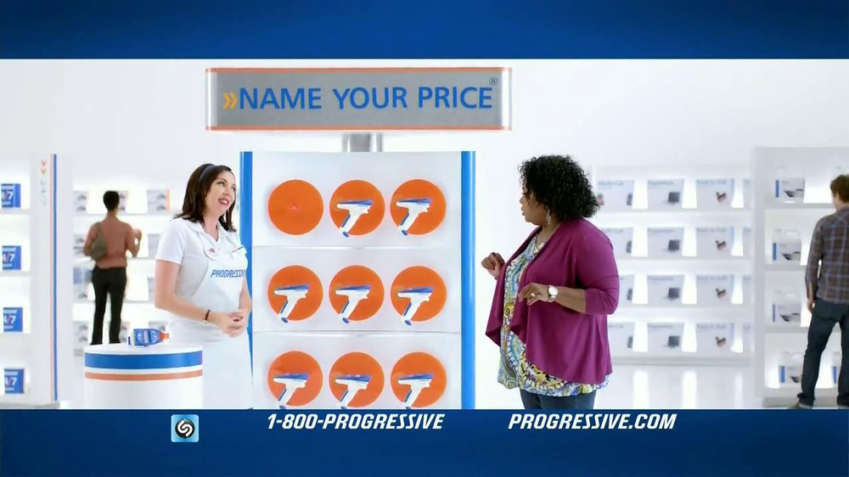
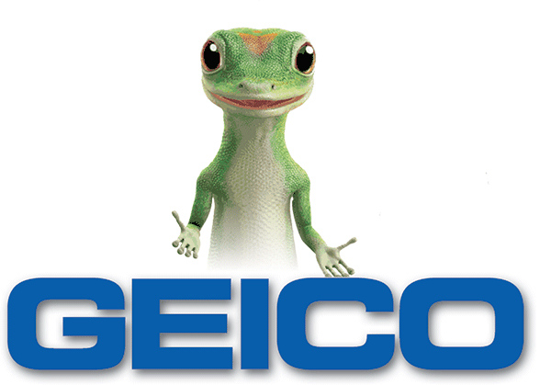

Slide 15


Slide 16
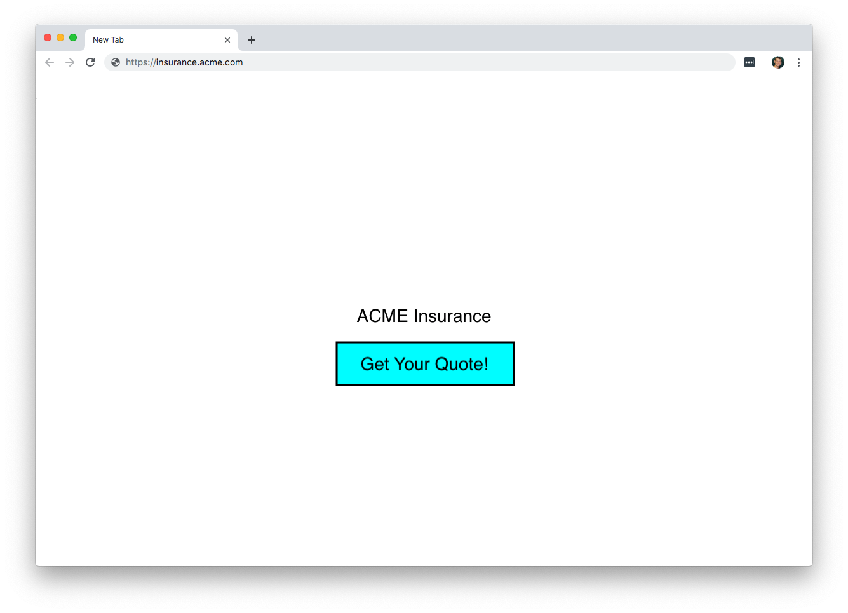

Slide 17
💵💰🐎🚗💰

Slide 18
2 years of my life
1 paying customer

Slide 19
5 Benefits of Serverless
📉
1) Reduced DevOps workload
2) Scalability
3) Pay as you go
4) Decoupled business logic
5) Quick deployments and updates
⚖️
💰
⛓️
🏇

Slide 20
Serverless would have
saved ACME Insurance

Slide 21
Serverless would have
helped ACME Insurance fail
with less bad.

Slide 22
5 Benefits of Serverless
📉
1) Reduced DevOps workload
2) Scalability
3) Pay as you go
4) Decoupled business logic
5) Quick deployments and updates
⚖️
💰
⛓️
🏇

Slide 23
👨‍💻 👩‍💻 🕰️ 👩‍💻 👨‍💻
App
Your server
Business Logic

Slide 24
5 Benefits of Serverless
📉
1) Reduced DevOps workload
2) Scalability
3) Pay as you go
4) Decoupled business logic
5) Quick deployments and updates
⚖️
💰
⛓️
🏇
Notes:
Hacker news or unexpected press. Most hits for your servers.

Slide 25
👱 💁 🙎 🤷 🧔 👴 👵 🧓
👶 👧 👦 👪 🐘 🦁 🐯 🐻
👨‍💻 👩‍💻 🕰️ 👩‍💻 👨‍💻
App
Your server
Business Logic

Slide 26
👱 💁 🙎 🤷 🧔 👴 👵 🧓
👶 👧 👦 👪 🐘 🦁 🐯 🐻
👨‍💻 👩‍💻 🕰️ 👩‍💻 👨‍💻
App
Your server
Business Logic

Slide 27
5 Benefits of Serverless
📉
1) Reduced DevOps workload
2) Scalability
3) Pay as you go
4) Decoupled business logic
5) Quick deployments and updates
⚖️
💰
⛓️
🏇

Slide 28
👱 💁 🙎 🤷 🧔 👴 👵 🧓
👶 👧 👦 👪 🐘 🦁 🐯 🐻
👨‍💻 👩‍💻 🕰️ 👩‍💻 👨‍💻
App
Your server
Business Logic
💰 💸 🤑

Slide 29
5 Benefits of Serverless
📉
1) Reduced DevOps workload
2) Scalability
3) Pay as you go
4) Decoupled business logic
5) Quick deployments and updates
⚖️
💰
⛓️
🏇

Slide 30
App
Your server
Business Logic

Slide 31
App
Your server
BL
BL
BL
BL
BL
BL
BL
BL

Slide 32
5 Benefits of Serverless
📉
1) Reduced DevOps workload
2) Scalability
3) Pay as you go
4) Decoupled business logic
5) Quick deployments and updates
⚖️
💰
⛓️
🏇

Slide 33
App
Your server
Business Logic

Slide 34
App
Your server
Business Logic

Slide 35
Business Logic
Business Logic
Business Logic
App
Somebody else’s servers
Business Logic

Slide 36
5 Benefits of Serverless
📉
1) Reduced DevOps workload
2) Scalability
3) Pay as you go
4) Decoupled business logic
5) Quick deployments and updates
⚖️
💰
⛓️
🏇

Slide 37
Downsides to Serverless
💸
1) Pricing is not transparent, and can fluctuate
2) Risk of vendor lock in
3) Debugging and troubleshooting can be painful
4) Hard to leverage legacy & on-premise data
🔒
🐛
🛑

Slide 38
Downsides to Serverless
💸
1) Pricing is not transparent, and can fluctuate
2) Risk of vendor lock in
3) Debugging and troubleshooting can be painful
4) Hard to leverage legacy & on-premise data
🔒
🐛
🛑

Slide 39
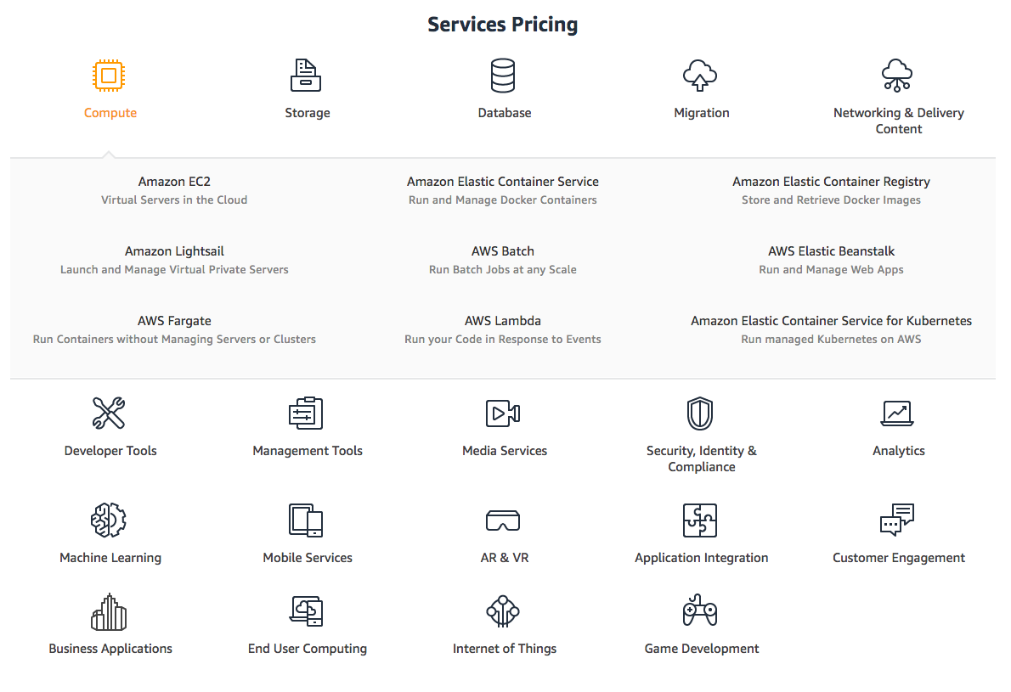

Slide 40
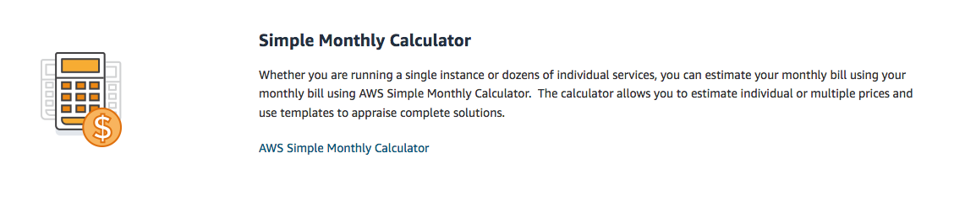

Slide 41
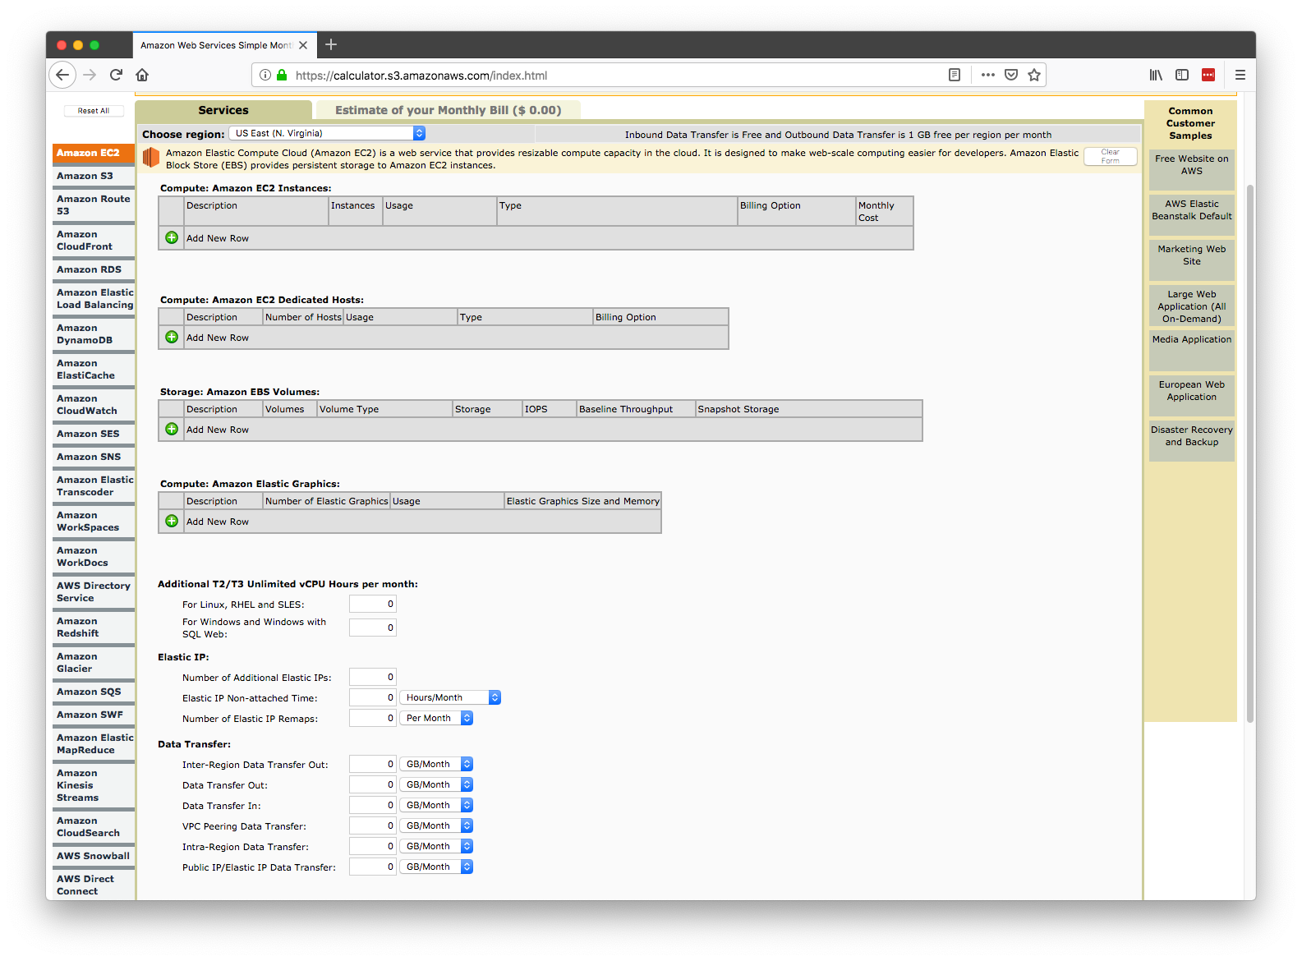

Slide 42
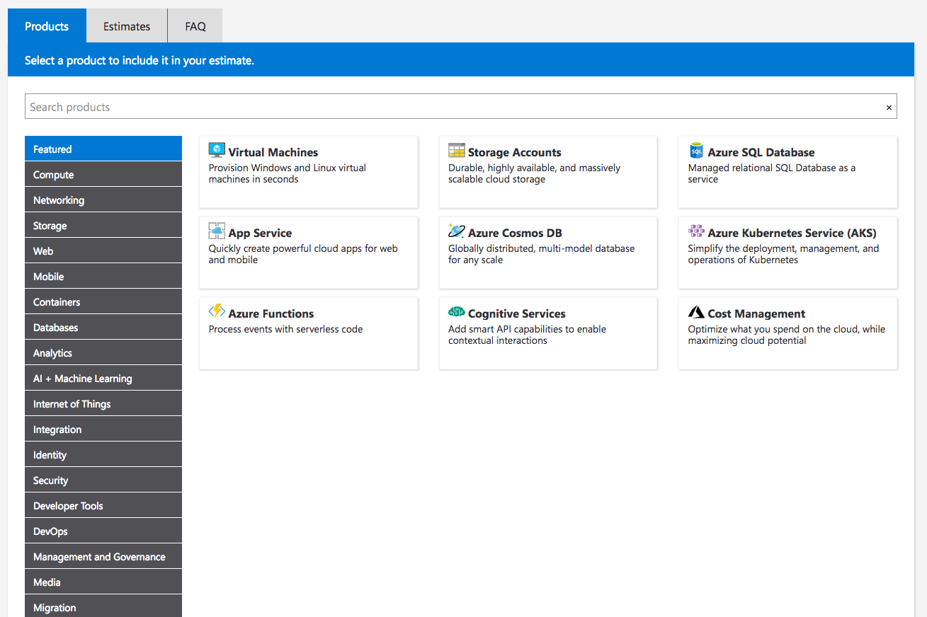
Notes:
Azure put in number of disk writes

Slide 43
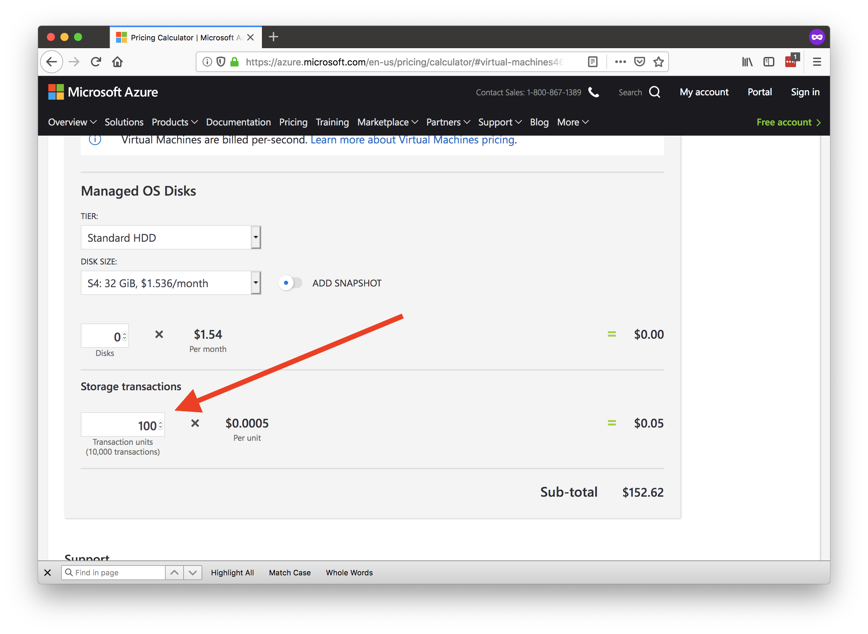

Slide 44
Downsides to Serverless
💸
1) Pricing is not transparent, and can fluctuate
2) Risk of vendor lock in
3) Debugging and troubleshooting can be painful
4) Hard to leverage legacy & on-premise data
🔒
🐛
🛑

Slide 45
Downsides to Serverless
💸
1) Pricing is not transparent, and can fluctuate
2) Risk of vendor lock in
3) Debugging and troubleshooting can be painful
4) Hard to leverage legacy & on-premise data
🔒
🐛
🛑

Slide 46
App
Your server
Business Logic

Slide 47
Business Logic
Business Logic
Business Logic
App
Somebody else’s servers
Business Logic
Notes:
End up writing custom code for specific cloud providers.
And in those situations your infrastructure can get so coupled to that provider that you’re sort of at their mercy, if they choose to raise prices, or you run into problems down the line.

Slide 48
Business Logic
Business Logic
Business Logic
App
Somebody else’s servers
Business Logic
Notes:
End up writing custom code for specific cloud providers.
And in those situations your infrastructure can get so coupled to that provider that you’re sort of at their mercy, if they choose to raise prices, or you run into problems down the line.

Slide 49
Downsides to Serverless
💸
1) Pricing is not transparent, and can fluctuate
2) Risk of vendor lock in
3) Debugging and troubleshooting can be painful
4) Hard to leverage legacy & on-premise data
🔒
🐛
🛑

Slide 50
Downsides to Serverless
💸
1) Pricing is not transparent, and can fluctuate
2) Risk of vendor lock in
3) Debugging and troubleshooting can be painful
4) Hard to leverage legacy & on-premise data
🔒
🐛
🛑

Slide 51
Business Logic
Business Logic
Business Logic
App
Somebody else’s servers
Business Logic

Slide 52
Downsides to Serverless
💸
1) Pricing is not transparent, and can fluctuate
2) Risk of vendor lock in
3) Debugging and troubleshooting can be painful
4) Hard to leverage legacy & on-premise data
🔒
🐛
🛑

Slide 53
Downsides to Serverless
💸
1) Pricing is not transparent, and can fluctuate
2) Risk of vendor lock in
3) Debugging and troubleshooting can be painful
4) Hard to leverage legacy & on-premise data
🔒
🐛
🛑

Slide 54
Business Logic
Business Logic
Business Logic
App
Somebody else’s servers
Business Logic

Slide 55
Your Servers
App
Business Logic
BL
BL

Slide 56
Notes:
Modern serverless, cloud platform that gives you the benefits, while trying to help you with some of the downsides to moving to a serverless architecture.

Slide 57

Benefits of Kinvey
Consistent pricing

Slide 58
Benefits of Kinvey
Consistent pricing
A powerful suite of data connectors

Slide 59


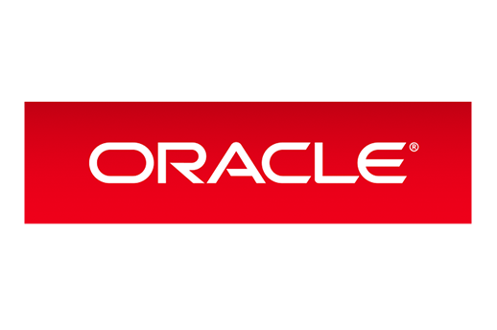
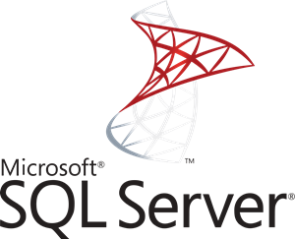
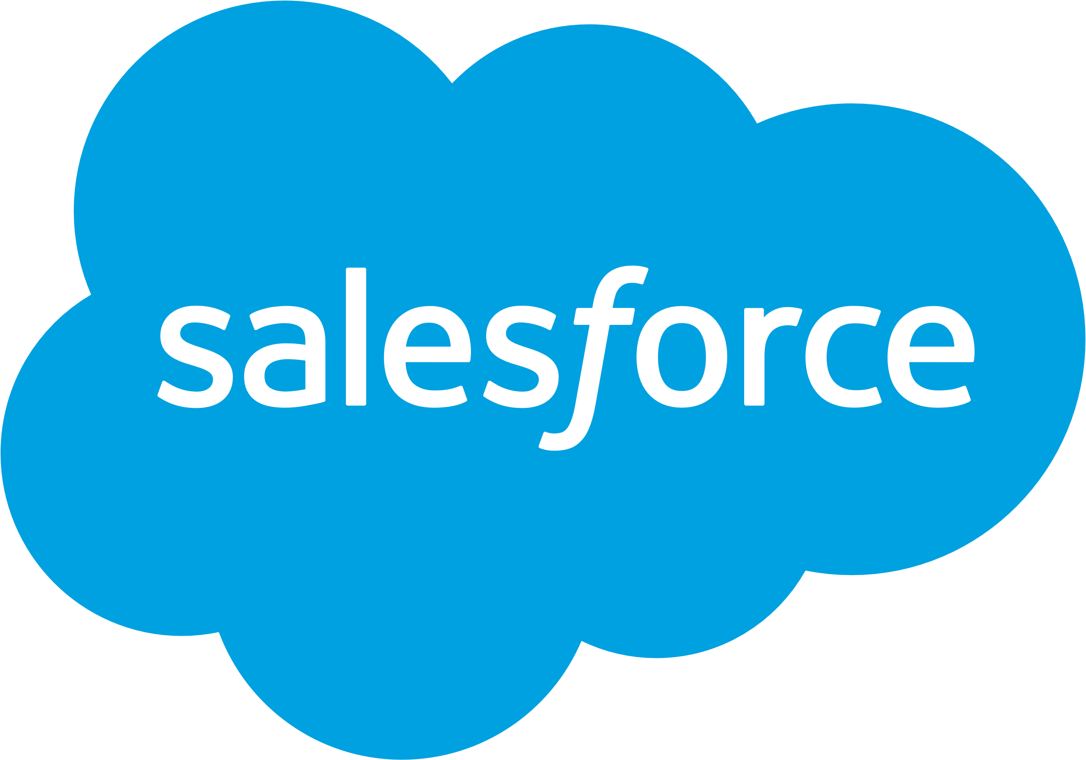

Slide 60

Benefits of Kinvey
Consistent pricing
A powerful suite of data connectors
Built-in compliance
Notes:
Open source tooling, developer-friendly SDKs

Slide 61
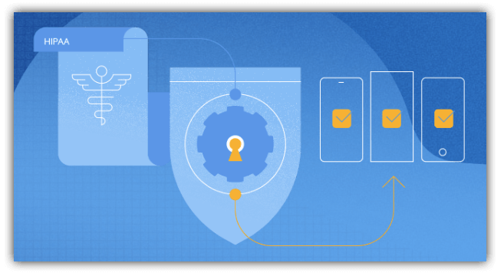
Built-in Compliance
HIPAA
SOC2
GDPR
Sarbanes-Oxley

Slide 62
Demos! 🎸

Slide 63
Business Logic
Business Logic
Business Logic
App
Somebody else’s servers
Business Logic
Notes:
Microservices

Slide 64
Business Logic
App
Somebody else’s servers
Business Logic
Notes:
Microservices

Slide 65
Thanks!
@tjvantoll
https://www.progress.com/kinvey

